Slide 1

Introduction to Text Analysis

Slide 2
Learning Objectives
Upon completing this assignment, students will:
Become familiar with basic concepts of natural language processing (NLP) and text analysis
Learn some of the commonly used techniques for preparing digital text for analysis

Slide 3
Natural Language Processing
Natural Language Processing (NLP) is a broad field encompassing the automated interpretation of human language.
Within NLP, text analysis is the process of extracting meaning from digital text. This original text data could be in the form of documents, webpages, news articles, email, social media posts, etc.

Slide 4
Why Use Text Analysis?
Text analysis is powerful because it can help extract useful information from large quantities of text data.
Text analysis minimizes the human effort required to consume digital text, and results in quantitative knowledge gathered from the digital text.

Slide 5
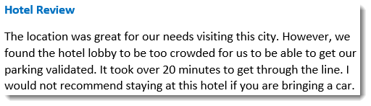
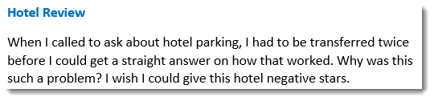
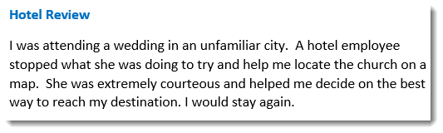
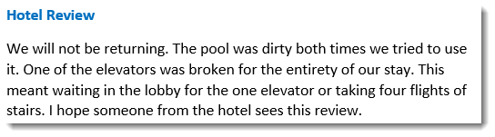
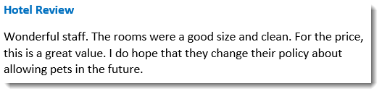
Why Use Text Analysis? (cont.)
For example, if you were director of customer satisfaction for a hotel chain, the online customer feedback would be important. You probably would not be able to efficiently read the thousands of reviews hotel guests leave on various websites.

Slide 6
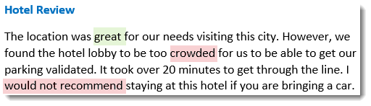
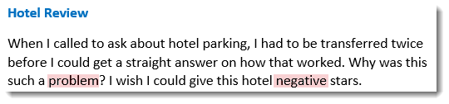
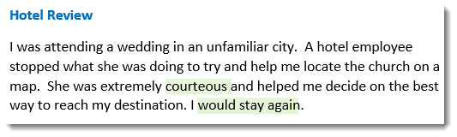
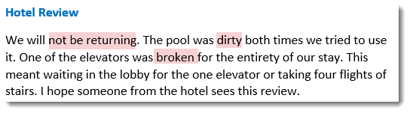
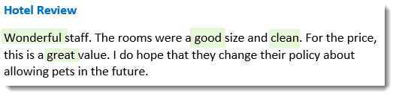
Why Use Text Analysis? (cont.)
Using one of the tools of text analysis—sentiment analysis—you can identify lists of “positive” and “negative” words/phrases and then automatically count the appearance of these words/phrases in the reviews.

Slide 7
Why Use Text Analysis? (cont.)
You can monitor the word frequency data from the reviews over time to see if positive or negative sentiment from customers statistically changes.

Slide 8
Preparing the Text Data
Before using more advanced tools such as sentiment analysis, it is useful to learn about some of the required steps used to prepare the data prior to the analysis.
Even if you are using a vendor’s off-the-shelf product for your text analysis needs, learning about the underlying techniques is necessary to consider the assumptions that may have been made during the preparation of the data.

Slide 9
Segmenting Text into Words
Exact steps for cleaning and preparing the raw text data will depend upon (1) the source of the text data, (2) the purpose of the analysis, and (3) your programming tools.
Processing large amounts of raw text for analysis always entails chopping it into smaller pieces.
Text is a linear sequence of characters/symbols and white spaces. A “token” is a series of characters treated as meaningful unit. Typically these would be words.

Slide 10
Tokenization
Word tokenization transforms the text into a series of word tokens. At this stage, certain characters—such as some punctuation—are typically also eliminated.
For example, the above English sentences would be turned into the following list of tokens:
‘tokenization’, ‘transforms’, ‘the’, ‘text’, ‘into’, ‘a’, ‘series’, ‘of’, ‘word’, ‘tokens’, ‘at’, ‘this’, ‘stage’, ‘certain’, ‘characters’, ‘such’, ‘as’, ‘some’, ‘punctuation’, ‘are’, ‘typically’, ‘also’, ‘eliminated’
The list of tokens becomes input for further processing.

Slide 11
Part of Speech (POS) Tagging
Tagging the tokens as nouns, verbs, adjectives, etc., is important for the accuracy of further steps of language processing.
POS-tagging takes a sequence of words and attaches a part of speech to each word using both the word’s definition and relationship with adjacent words.

Slide 12
Out of Vocabulary - OOV
When words are not in the system’s dictionary they are considered “out of vocabulary,” or OOV.
Depending on the dictionary and rules your system is using, proper nouns, professional jargon, compound words, abbreviations, and slang may be OOV words.
Keep in mind your system may be designed to eliminate OOV words while “cleaning” text--even though retaining these non-standard words may be important to your final analysis.

Slide 13
Lemmatization
Lemmatization is the process of reducing words down to their base form, or dictionary form, known as the lemma.
The verb “to eat” may appear in the text as “eat,” “ate,” “eats,” or “eating.” The base form, “eat,” is the lemma for the word.
Generally, lemmatization means removing inflectional endings. However, reducing the word to its lemma may also mean substitution of a synonym based on context.

Slide 14
Lemmatization (cont.)
For example, review the following sequence of tokens before and after lemmatization:
Before lemmatization:
‘a’, ‘background’, ‘in’, ‘statistics’, ‘is’, ‘expected’,
Lemma:
‘a’, ‘background’, ‘in’, ‘statistic’, ‘be’, ‘expect’,

Slide 15
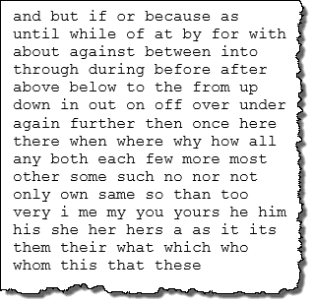
Removing Stop Words
x
The next step is typically to filter out the most commonly used words in the English language. These are words used to construct meaningful sentences, but are not very meaningful in themselves.
These words are called stop words.
There is no universal list.
A typical stop word list has approx. 125-150 words.

Slide 16
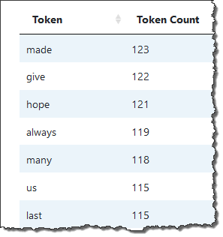
Counting Words
Taking the filtered list and running a word frequency process determines the number of times each token occurs in the digital text being analyzed.
Word frequency, a measure of the relative weight given to a word in the corpus analyzed, is typically a precursor to further analysis, such as sentiment analysis, readability analysis, and topic modeling.

Slide 17
Adjacent Words
Collocation refers to words commonly appearing near each other. An example is a bigram, which is two adjacent tokens in a sequence of tokens.
Returning to the hotel review example, guests often indicate whether they would “stay again” or “not stay” (again). Counting the occurrence of those two bigrams could be relevant as indications of positive or negative sentiment.
unigram = 1 token bigram = 2 adjacent tokens trigram= 3 adjacent tokens n-gram = n adjacent tokens

Slide 18
Notes on Text Preparation
It is worth being aware of the text preparation in order to make sure something important to your final analysis has not inadvertently been “cleaned.”
For example, we noted in the hotel reviews that the bigrams “would stay,” and (would) “not stay” could be important indicators of sentiment. However, the word “not” is usually included in stopword lists. Expertise in the text being analyzed is key to achieving better results.

Slide 19
Links to Assignment
Use these two links to access interactive text processing activities. There are two options:
The first uses health care-related Tweets. Each corpus is made up of Tweets from a different news source. https://wrds-www.wharton.upenn.edu/classroom/natural-language-processing-healthcare/
The second uses the entire text of Jane Austen’s Pride and Prejudice as the corpus. https://wrds-www.wharton.upenn.edu/classroom/natural-language-processing/

Slide 20
Activity Notes
In each application, the frequency distribution has been visualized as a word cloud. In word clouds, the size of each word indicates its relative frequency.
Select different options in the interactive tool to see what happens to the word cloud as you choose among different text processing methods.
A data table beneath the word cloud contains the complete word lists.

Slide 21
Conclusion
Text analysis uses automated processes to extract meaning from digital text.
Tokenization, part-of-speech tagging, lemmatization, and the elimination of stop words are all techniques used to prepare raw digital text data for analysis.
Counting the frequency of specific words in the text can provide helpful information about the text, and is a precursor to further analysis.

